Slide 1

National Rural Support Programme
(NRSP)
August 2026
National direct access
accredited entity of

Slide 2
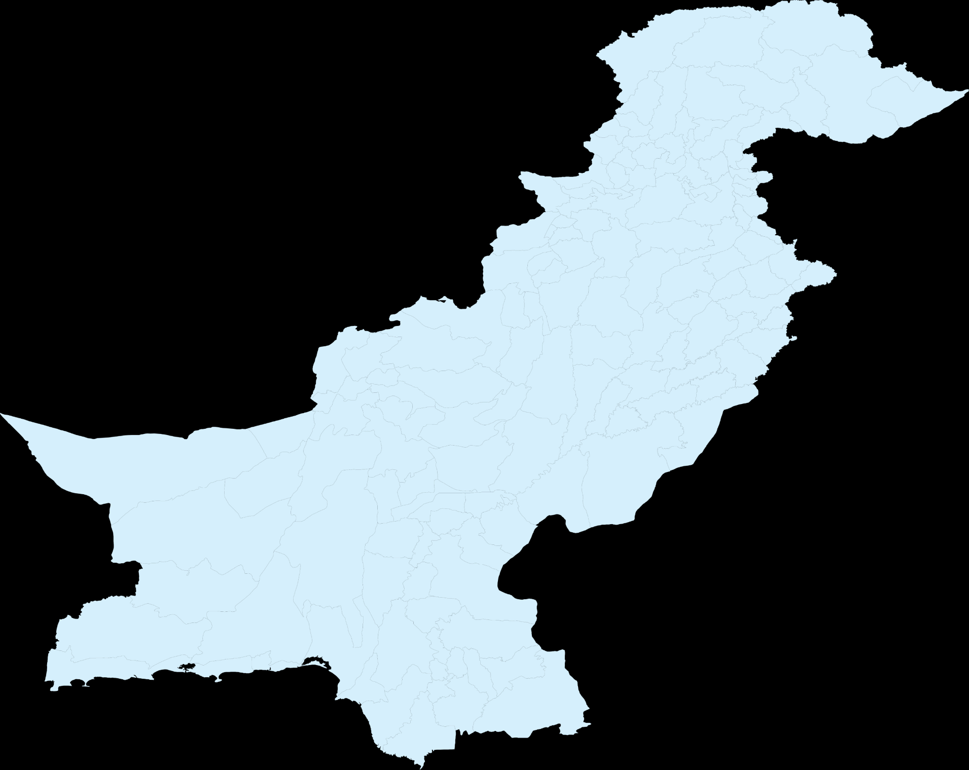
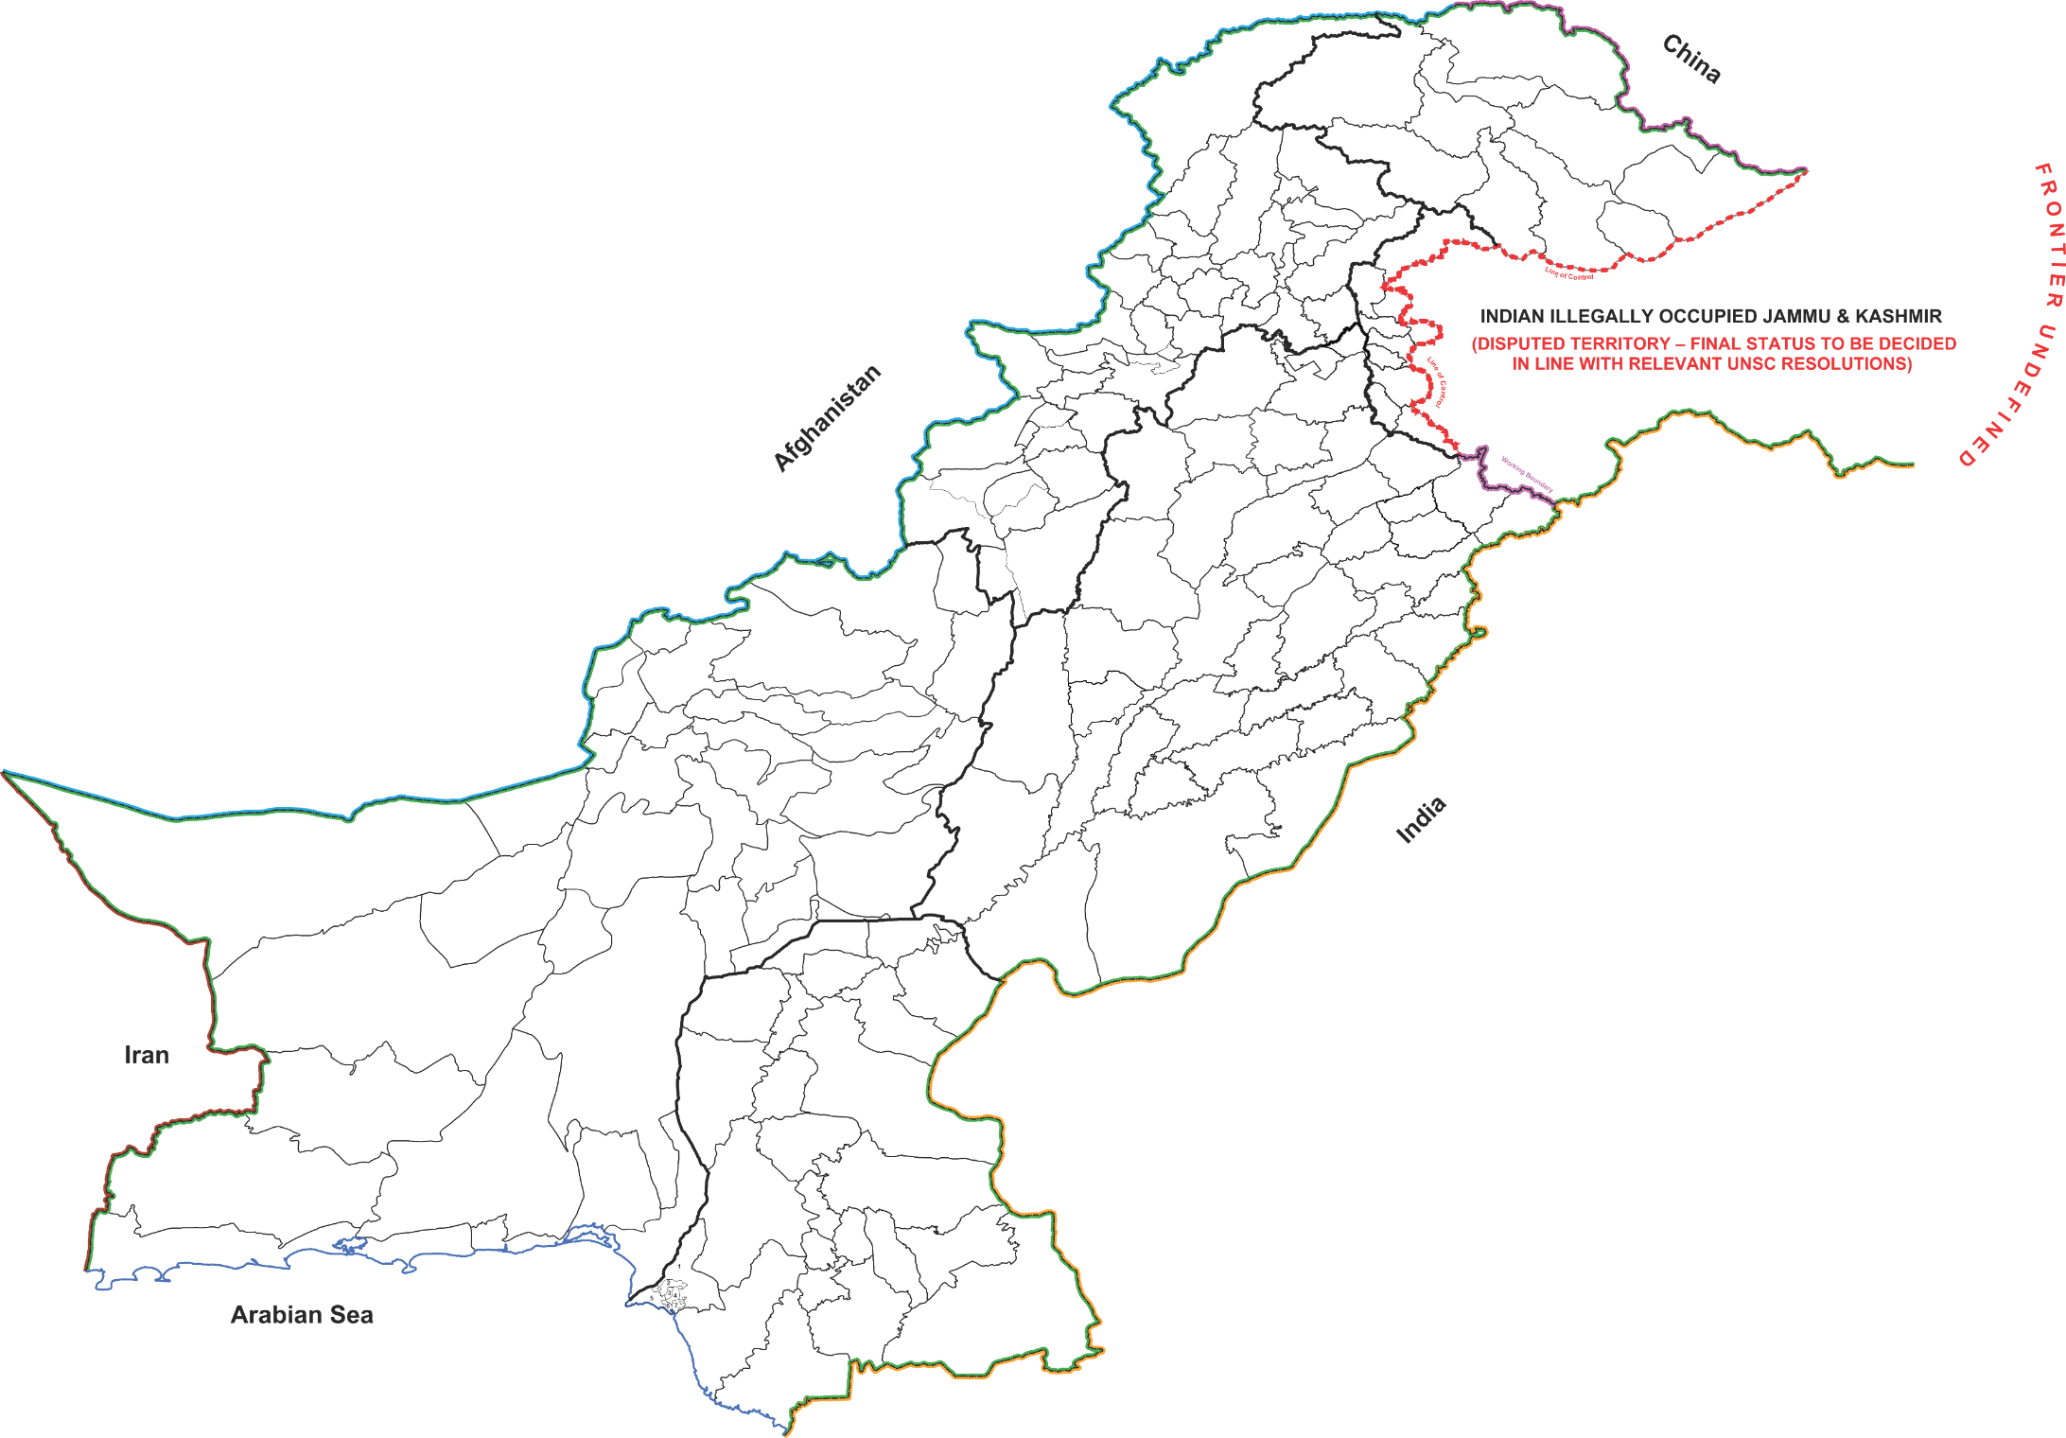
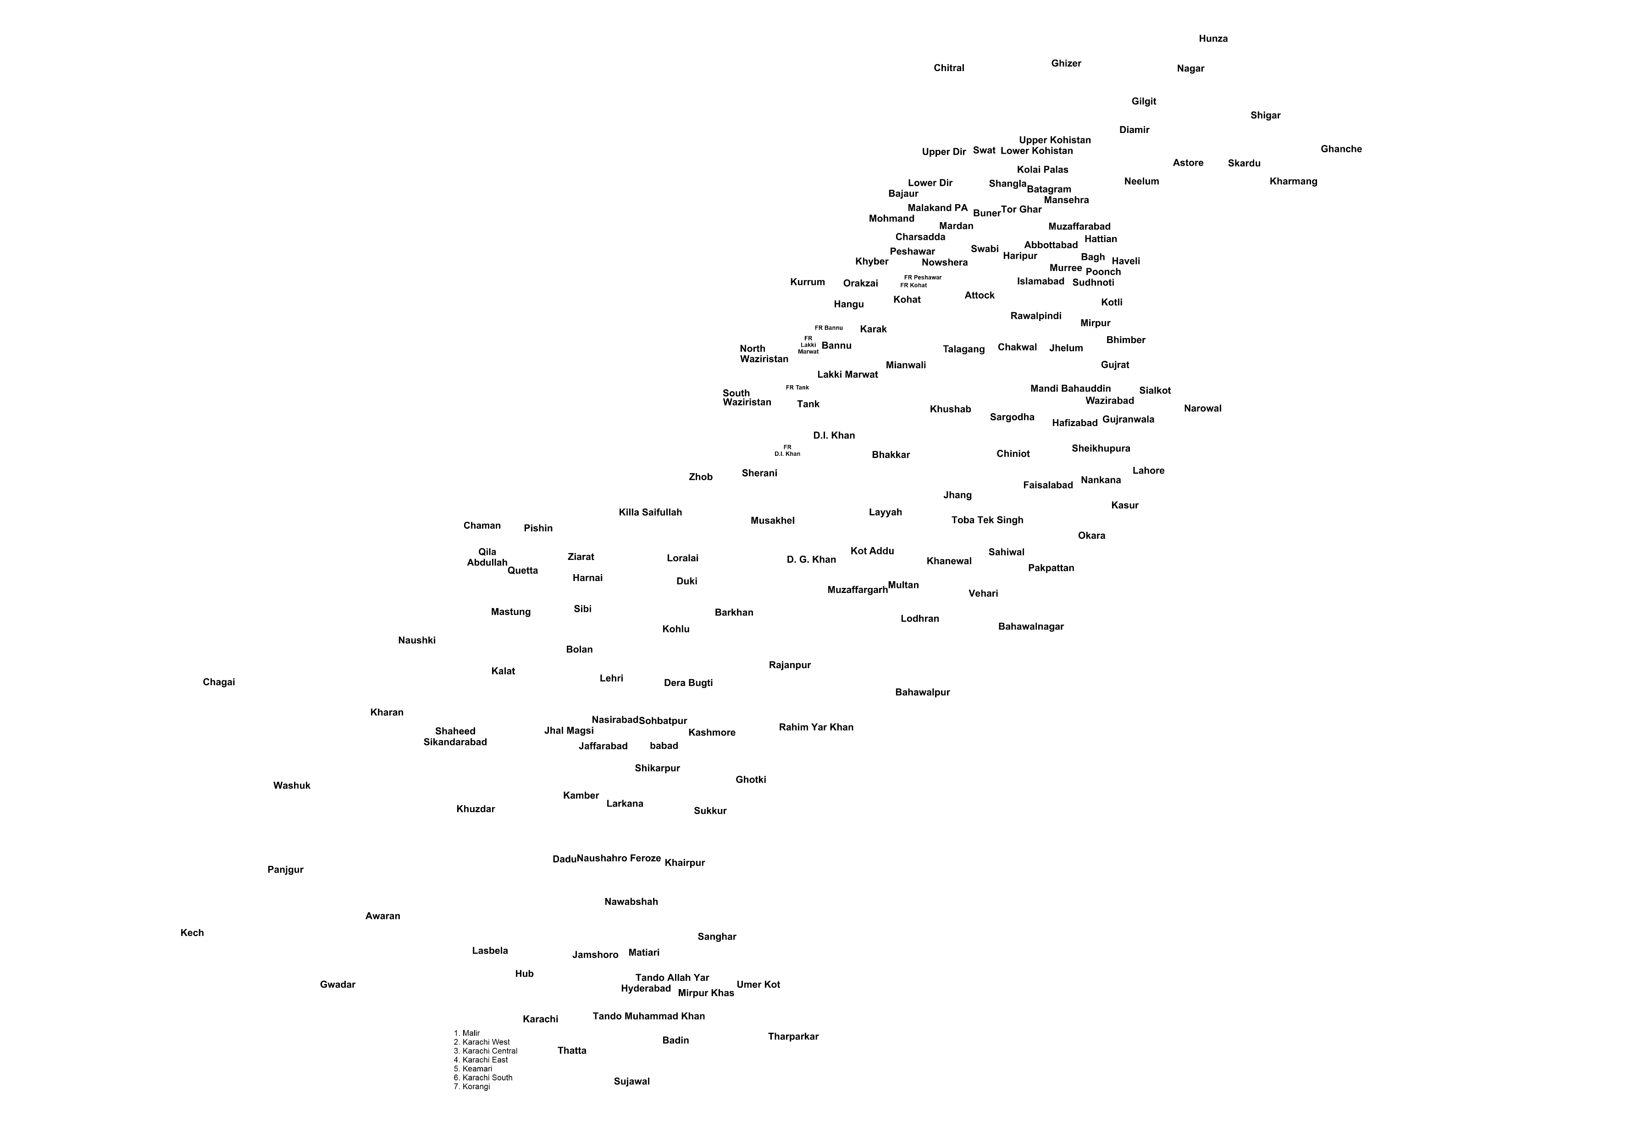
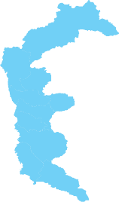

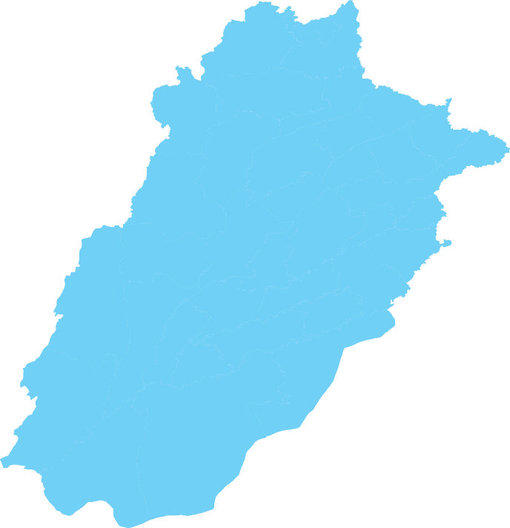
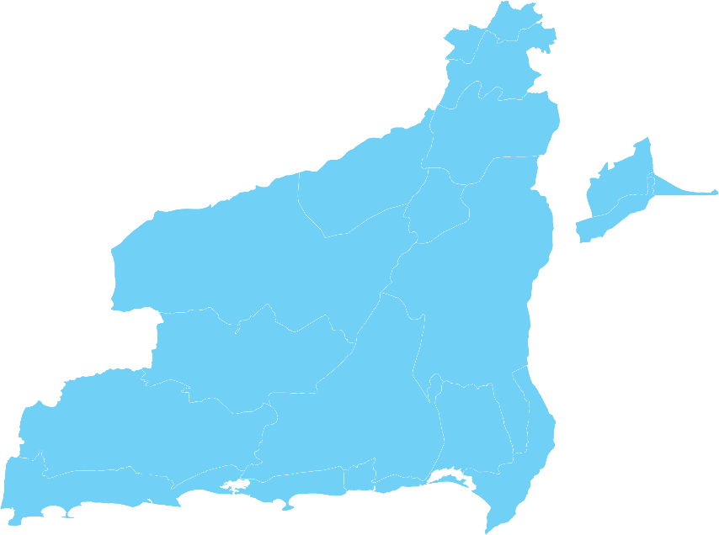
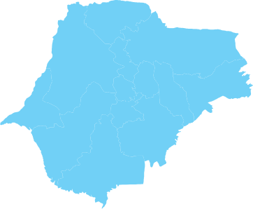
NRSP’s Outreach
NRSP Programme Districts
NRSP Hub Offices
NRSP District Offices
NRSP Project Offices
NRSP Field Units
UPAP Districts
4
Provinces & AJK
88
Programme Districts
267
Field Units
804
Settlement Offices

Slide 3
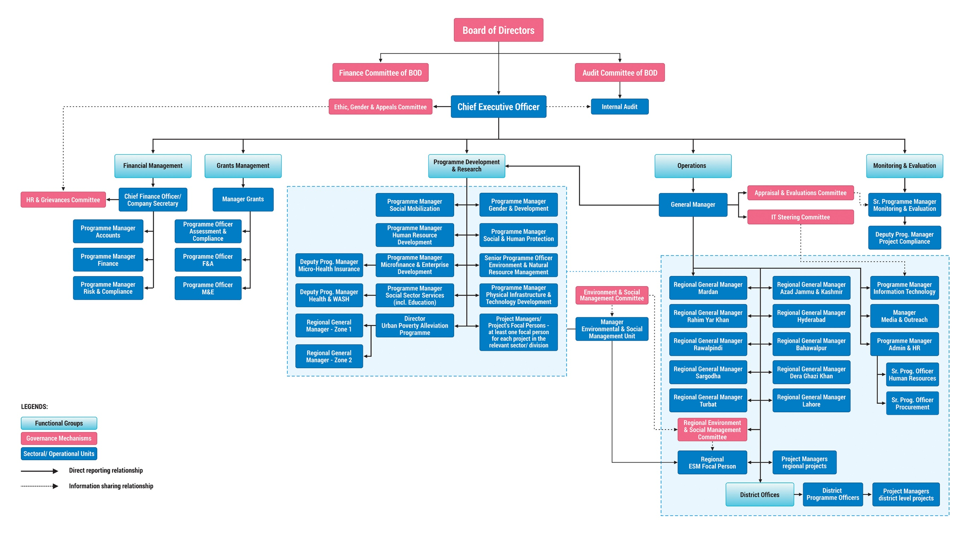
Organization Structure of NRSP

Slide 4
NRSP: Vision, Mission and Strategy
Vision
All rural households in the country are organized into vibrant and inclusive institutions for poverty reduction and sustainable development
Core Assumption
People have tremendous potential and willingness
Organizational Objective
To foster a countrywide network of grassroots level organizations to enable rural communities to plan, implement and manage developmental activities and programmes for the purpose of ensuring productive employment, alleviation of poverty and improvement in the quality of life
Organizational Strategy
To harness peoples potential to help themselves

Slide 5
Steps and Processes to undertake Development
Situational Analysis and Poverty Assessment
Offering partnership to community specially the poor through a series of Programme dialogues
Organize willing communities at settlement/mohalla level as Community Organizations (COs) for pooling of resources, cutting down overheads, achieving economies of scale etc
The COs federate at Village level into Village Organizations (VOs) and VOs federate at Union Council levels as Local Support Organizations(LSOs)
Identify true and genuine Activists and Community Resource Persons (CRPs) from amongst the community. It is only they who can harness the potential of the people not outsiders

Slide 6
Steps and Processes to undertake Development (Conti...)
Identify and prioritize what people are willing to undertake in terms of opportunities and needs but not demands (Micro Investment Plans, Village Development Plans)
Undertake feasibility of identified opportunities and needs in terms of peoples capacity, willingness, equity, sustainability, availability and requirement of resources
Facilitate the flow of required resources to the community; and
Monitor, lobby and establish linkages between communities and other development agencies, such as government departments and donors

Slide 7
Situational Analysis and Poverty Assessment
  Village/Union Council level Socio Economic Survey
    Local economic factors, professions, landholding, natural resources etc
    Levels of education, health, Public infrastructure, imports and exports of the village; and the communities’ perception on the problems of utmost importance confronting them and past efforts to overcome them
  Carpet survey/census of all households in a union council using the Poverty Score Card approved for the BISP. The results are analysed into different poverty bands to identify intervention for each band
Categories | Score Range
Ultra-poor/ Extremely poor | 0-11
Vulnerable poor/ Chronically poor | 12-18
Transitory Poor | 19-23
Transitory Vulnerable | 24-40
Non-Poor | 41 and above

Slide 8
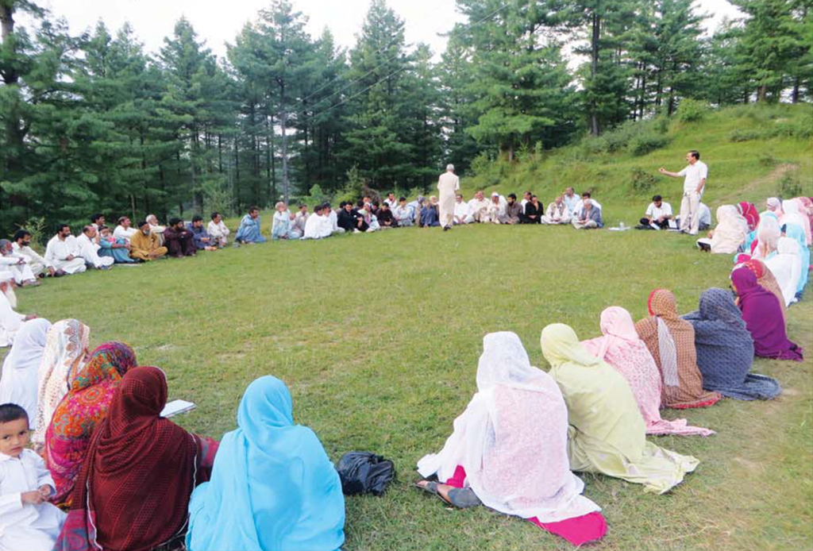
Formation of Community Organizations (COs)

Slide 9
Preparation of Micro Investment Plans (MIPs) and Village Development Plans (VDPs)
Levels | Plans and Needs Identified | Interventions
Household Level Plans (MIPs) | Income Generation | Income generating grants, asset transfer for the destitute Access to loans capital (CIF, micro credit, savings) Skills enhancement trainings leading to employment generation
Village Level Plans (VDPs)/UC Plans | Community infrastructure schemes for clean drinking water, irrigation, sanitation etc Health and family planning services Education WASH services Productivity enhancement of agriculture and livestock | Access to technical (engineering) and financial services to accomplish the identified plans Support for project design, resource mobilization and development of linkages with local government and other development organizations

Slide 10
NRSP’s Development Sectors
Social Mobilization (SM)
Human Resource Development (HRD)
Microfinance & Enterprise Development Programme (MEDP)
Gender And Development (Cross cutting)
Physical Infrastructure and Technology Development (PITD)
Environment and Natural Resource Management (E&NRM)
Social Sector Services (Health, Education & WASH)
Social & Human Protection

Slide 11
Social Mobilization: Federating the COs
Local Support Organization (LSO)
>Federation of Village Organizations at UC level
> LSO Leaders, Executive Committee and
General Body
> Exec Comtt.: all VO leaders; General Body: All
CO leaders
> All villages represented in LSO
LSO
Village Organization (VO)
> Federation of Community Organizations
> Leaders and General Body (all CO Presidents
and Managers)
> All mohallas/settlements represented in VO
> 100% inclusion of poorest households through
COs
VO
Community Organizations (COs)
> Participatory body (Leaders and Members)
> Separate COs for Men and Women (if required)
> Each CO to have 15-25 members
CO
CO
CO

Slide 12
Core Business of NRSP: Fostering a Three-Tiered Social Mobilization Network
President
930
(LSOs)
3.99 Million
households organized
LSO
Manager
President
Manager
8,993
(VOs)
VO
VO
HH Member
Manager
CO
President
CO
CO
261,425
(COs)

Slide 13
What is a Community Organization (CO)
Group of people (about 10-25 households); one from each household , live in same geographical proximity and share common interests
Select their own office bearers (President and Manager)
Meet Regularly
Member households save and pool their individual savings into a joint CO account
Decision by absolute majority, in general body and in writing

Slide 14
Social Mobilization: Summary of Achievements
Description of activities | Female | Male | Mix | Total
Community Organizations (COs) formed | 139,408 | 96,449 | 25,568 | 261,425
CO Membership (million) | 2.44 | 1.56 | - | 4.00
CO Savings (PKR million) | 236.51 | 1,307.91 | - | 1,544.42
Village Organizations (VOs) formed | - | - | 8,993 | 8,993
Local Support Organizations (LSOs) formed | - | - | 930 | 930

Slide 15
Grant support to the poorest/destitute
440,819 poorest rural household have benefited from micro grants for productive assets/IGG:
  Small and large livestock, assets and tool kits for the establishment of enterprises/ businesses, income generating grants, grants for rehabilitation/recovery after emergencies etc
  50% women beneficiaries
Major donors/funding agencies:
  PPAF, Government of Pakistan, IFAD, UNDP, EU, World Bank, Kfw, ADB, Google, Government of Italy etc

Slide 16
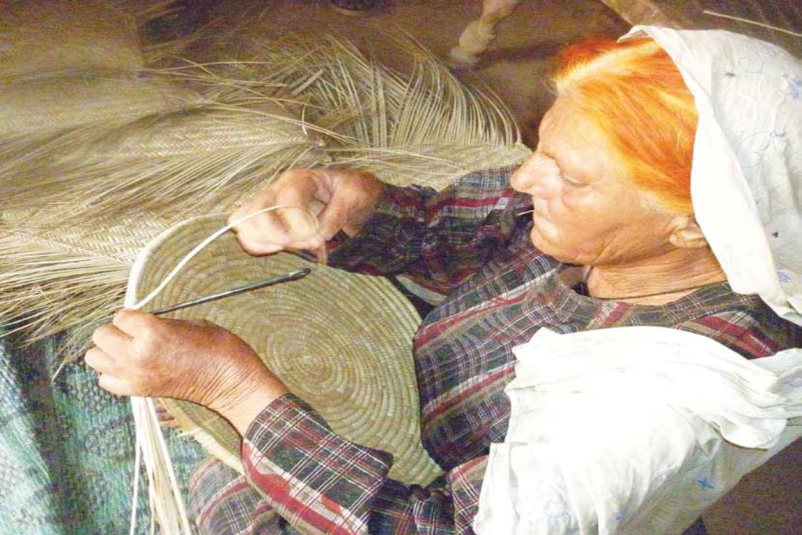
Microfinance and Enterprise Development Programme (MEDP)

Slide 17
Microfinance Products
MEDP Products | Description
Community Investment Fund (CIF): Community Managed Financial Services | CIF grant provided to women COs, VOs and LSOs who use it as revolving credit fund to extend loans to the poor who are not served by NRSP
Interest Free Loans | Government’s schemes to provide interest free loans to clients identified through Poverty Scorecard (0-23)
Core microcredit | Small loans as working capital provided to urban and rural clients for agriculture, livestock and small businesses
Micro Health and accidental death Insurance | Micro credit client and spouse are provided insurance cover to meet expenses on hospitalization, disability and accidental death

Slide 18
MEDP: Summary of Achievements
Description | Female | Male | Total
Credit disbursement (PKR billion) | 355.65 | 198.79 | 554.45
# of Loans (million) | 9.33 | 4.67 | 14.00
Portfolio (PKR billion) | 75.54 | 46.81 | 122.36
Active Loans | 553,325 | 171,103 | 724,428
CIF Disbursements (PKR million) | 4,550.59 | 796.26 | 5,346.85
# of CIF Loans | 211,333 | 28,539 | 239,872
CIF Portfolio (PKR million) | - | - | 526.20
CIF Active Loans | 26,330 | 1,767 | 28,097

Slide 19
Micro Credit Disbursement by Gender
Credit Line | Male Beneficiaries | Female Beneficiaries
Agriculture Inputs | 92% | 8%
Livestock Development | 18% | 82%
Enterprise Development | 31% | 69%
Small Infrastructure as Individual Enterprise (SIIE) | 85% | 15%
Tijarat | 3% | 97%

Slide 20
Micro Health Insurance: Summary of Achievements
Description | Total
Total # of Person Insured | 6,970,101
Total # of Insurance Cases | 9,207,802
Total # of Beneficiaries | 15,388,470
Premium Collected (PKR) | 1,270,002,404
Total # of Claims Received at HO | 73,321
Claims Approved | 58,410
Claims in Process | 9,652
Claims Rejected | 5,259
# of Claims Reimbursed to the Clients | 58,410
Amount Reimbursed (PKR) | 808,738,169

Slide 21
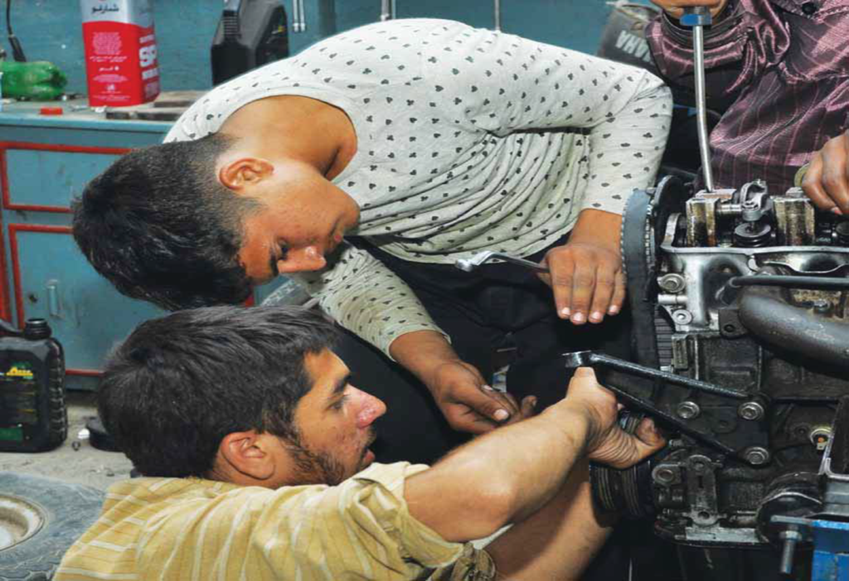
Human Resource Development Programme
Mandatory training for community leaders and managers in leadership and managerial skills
Mandatory NRSP Orientation Training Workshop (OTW) for all staff
Demand/market based vocational and technical skills training programme

Slide 22
HRD: Summary of Achievements
Training Types | Male | Female | Total
Community Management Training Programme | 142,940 | 346,293 | 489,233
Natural Resource Management Training Programme | 30,646 | 38,238 | 68,884
Social Sector Training Programme (SSTP) | 218,442 | 214,136 | 432,578
Physical Infrastructure and Technology Development | 21,694 | 6,724 | 28,418
Enterprise Development Training Programme (EDTP) | 21,338 | 111,536 | 132,874
Vocational Training Programme (VTP) | 44,903 | 68,868 | 113,771
Occupational Training Programme (OTP) | 7,400 | 72,592 | 79,992
Refresher Courses | 25,801 | 20,299 | 46,100
Activist Workshops | 1,311,693 | 2,385,902 | 3,697,595
Subject Specialist Workshops | 221,939 | 179,411 | 401,350
Exposure Visits | 10,104 | 9,512 | 19,616
World Bank - JSDF Project | 52,491 | 30,933 | 83,424
Sub-total Community Trainings | 2,109,391 | 3,484,444 | 5,593,835
Sub-total Staff Trainings | 78,371 | 40,322 | 118,693
Grand Total | 2,187,762 | 3,524,766 | 5,712,528

Slide 23
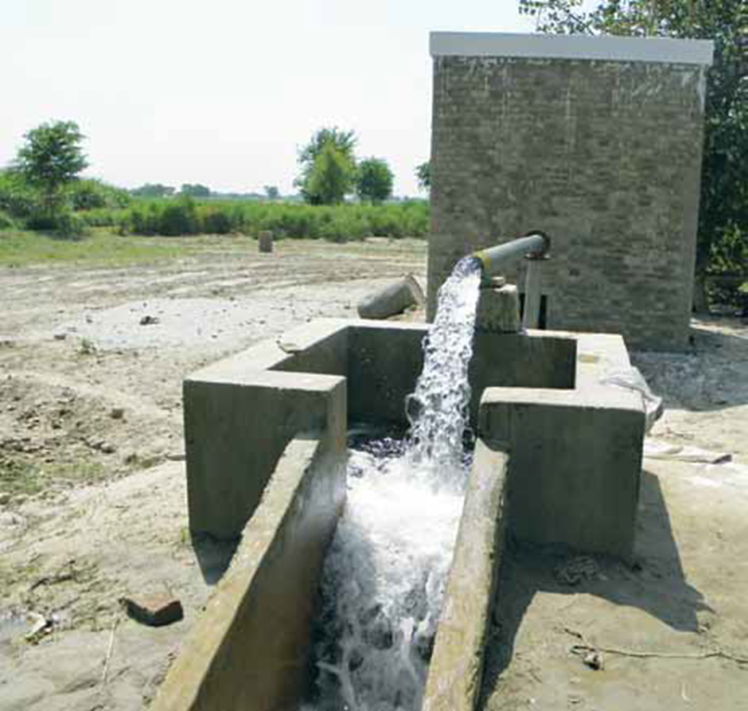
Physical Infrastructure and Technology Development Programme (PITD)
The COs/VOs identify the scheme
The COs/VOs participate in the implementation of the scheme
The COs/VOs take responsibility for Operation and Maintenance

Slide 24
PITD: Summary of Achievements
Type of Community Infrastructure Schemes | # of Schemes | Beneficiary Households | Approved contribution (PKR M) | CO contribution (PKR M) | Total (PKR M)
Drinking Water Supply | 8,672 | 385,325 | 2,703.37 | 341.74 | 3,045.10
Agriculture | 13,219 | 182,329 | 2,803.84 | 865.51 | 3,669.35
Communication | 4,266 | 287,975 | 2,320.58 | 203.69 | 2,524.26
Sewerage and Drainage | 5,797 | 397,091 | 4,340.61 | 450.54 | 4,791.15
Others | 13,561 | 951,722 | 5,842.71 | 652.24 | 6,494.95
Total | 45,515 | 2,204,442 | 18,011.10 | 2,513.72 | 20,524.82

Slide 25
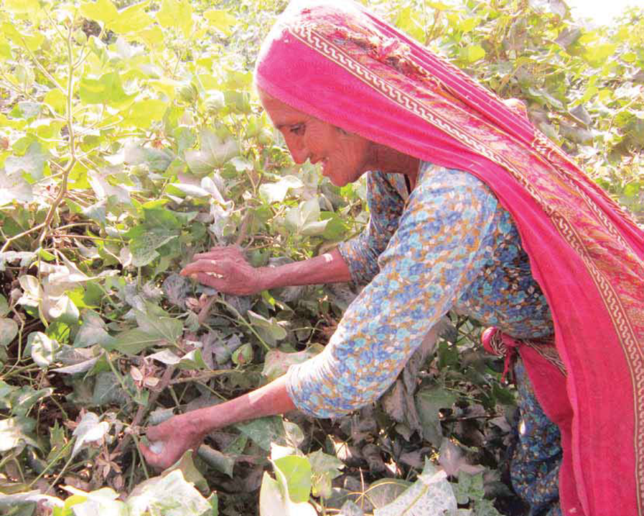
Environment and Natural Resource Management (ENRM)
Forges linkages with government line agencies and private service providers
Imparts training to farmers
Fosters Community Resource Persons/Workers
Provides knowledge and information about methods of managing agriculture and livestock
Implements special projects e.g Sugarcane Productivity Enhancement Project
Prime Minister’s Initiative for Livestock
Ongoing Vaccination Programme
Agriculture Innovation Programme

Slide 26
ENRM: Summary of Achievements
Description of Activities | Quantity | Beneficiary Households
Construction of Mini-Dams | 397 | 2,004
Construction of Dug-Wells | 1,902 | 3,367
Drip-Irrigation Schemes | 63 | 378
Livestock Vaccinated | 5,169,035 | 1,265,792
Livestock Treated | 51,223,58 | 25,611,80
Livestock De-wormed | 2083,917 | 231,730
Livestock Inseminated | 14,620 | 14,620
CLEWs Trained | 1,293 | 1,293
Ponds Construction | 590 | 2,717
Biogas Plants Installed | 470 | 437
Solar Lighting Units Installed | 3,120 | 3,583
Fruit and Forest Tree Planted | 11,808,804 | 501,381
Orchards and Nurseries Established | 31,084 | 10,155
Productivity Enhancement Field Days | 39,533 | 277,873
Access to Microfinance Loans for Farmers | 86,665(million) | 3,984,358

Slide 27
Social Sector Services
Education
  Increasing access to education by supplementing the government efforts and participating in donor programmes
  Collaboration with Provincial Education Sector Strengthening Programme, Provincial Education Foundations
  Capacity building of Schools Management Committees, Teachers Training, Schools Improvement Plans, Missing facilities
  Early childhood education
  Adult Literacy and education for girls
  Establishment and support for community Schools
Health
  Increasing access to health services by supplementing the government efforts;
  Immunization and Polio Initiatives
  Participation in projects for Mother and child health care, Reproductive health and family planning, Nutrition
  Malaria prevention and control
  Support to people with functional disabilities
  Medical camps, Eye care initiatives etc

Slide 28
SSS: Summary of Achievements
Description of Activities | Quantity
Education
Community Schools Established and Supported | 542
Government Schools Supported | 31,151
Students Enrolled (Managed Schools and Awareness Raising) | 1,685,735 (49% Girls)
Non-Formal Education/Literacy/EC Centers Established | 2,001
Government and Community Teachers Trained | 84,626 (57% Females)
Schools Management Committees (SMCs) Formed | 50,847
Health
Awareness Raising on Mother & Child Health (Beneficiaries) | 6.6million
Child Vaccination | 827,929
Vaccination for Pregnant Women | 509,002
Beneficiaries of Artificial Limbs Services | 46,075
LLINs Distributed (Beneficiaries) | 2,044,627
Traditional Birth Attendance (TBAs) Trained | 696
Water, Sanitation and Hygiene
Beneficiaries of Health and Hygiene Awareness Raising | 10.7 million
Construction of Toilets / Self help Latrines | 488,957
Villages Certified for ODF status | 5,949

Slide 29
Major Contracts/Projects
A major Partner Organization (PO) of the Pakistan Poverty Alleviation Fund (PPAF) (funding GoP, World Bank, IFAD, KFW, Italian Fund) since year 2000
USAID Small Grants and Ambassador’s Fund (SGAFP)
Union Council and Community Economic Strengthening Support (SUCCESS) Programme in Sindh (EU)
Balochistan Rural Development Community Empowerment Programme (BRACE)
UCBPRP in Sindh
IFAD/Provincial Governments projects Gwadar/Lasbella Livelihood Support Project (GLLSP), Southern Punjab Poverty Alleviation Programme (SPPAP) funded projects, Barani Village Development mobilization expertise in the specific issues of the rain-fed areas of Punjab
Asian Development Bank/Provincial Government funded Dera Ghazi Khan Rural Development Project, Agriculture Component of Swabi Scarp Project building NRSP’s capacity for working in poor and remote districts of southern Punjab, Sustainable Livelihoods in Barani Areas Project (SLBAP), Sindh Coastal Community Development Project (SCCDP)
National Poverty Scorecard Survey for BISP
National Poverty Graduation Programme in Sindh, Punjab and Balochistan
Prime Minister’s Special Initiative for Livestock Project
Education/Health Projects with provincial departments, USAID, UNICEF, World Bank, DFID etc
Disaster Management and Response projects with various donors
Punjab Human Capital Investment Project-Economic Inclusion Package 1, 2 & 3.
E – Agricultural financing to the small landholders

Slide 30
NRSP as Relief, Rehabilitation and Reconstruction Organization
Preparing communities for disaster risks assessment and management
Participation in rescue efforts with government agencies
Participation in relief efforts in collaboration with local communities, donors and governments
Special projects for recovery and rehabilitation
Reconstruction of houses and local infrastructure (over 40,000 houses)

Slide 31
Existing Oversight Mechanism
NRSP has a 11 members BoD, including 3 Federal Secretaries as ex-officio Directors. Board meetings are held on a quarterly basis
External statutory Annual Audit:
    A.F.FERGUSON & Co.
Internal Audit
    Internal Audit Department set up under the direct supervision of the Chairman Internal Audit Committee of the Board;
    Secretary Finance member of the Audit Committee
Separate audit by donors for every project
Institutional assessments by donors
Pre-award institutional assessments carried out by USAID and EU
Micro assessments done by UNDP, UNICEF, OXFAM and many other institutions

Slide 32
Systems in place and Financial Capacity
Manuals for Financial Management, Internal Audit, HR, Procurement, Social Mobilization, IT, Physical Infrastructure and Technology Development, Microfinance and Enterprise Development , MER and HRD
Strong IT section to design and maintain MIS
Policy guidelines and major approvals by Finance Committee and oversight by the Internal Audit Committee of the Board of Directors
Ability to access commercial credit lines
Over 500 Bank Accounts
Strong HRM and HRD system in place
Strong Procurement system in place
Projects Tracking Systems
Weekly, monthly, six monthly Programme Planning Meetings at all levels

Slide 33
NRSP as a Support Organization
Played its role for establishing and strengthening the following organizations/RSPs
  Ghazi Barotha Taraqiati Idara (GBTI)
  Punjab Rural Support Programme (PRSP)
  Rural Support Programmes Network (RSPN)
  Khushhali Bank
  Sindh Rural Support Organisation (SRSO)
Support RSPs and other development organizations for the following
  Project design, operational management and M&E
  Selects sponsors
  Registration
  Recruitment and training of staff
  Corporate matters for initial period
  Financial management systems
  Support to establish IT systems

Slide 34
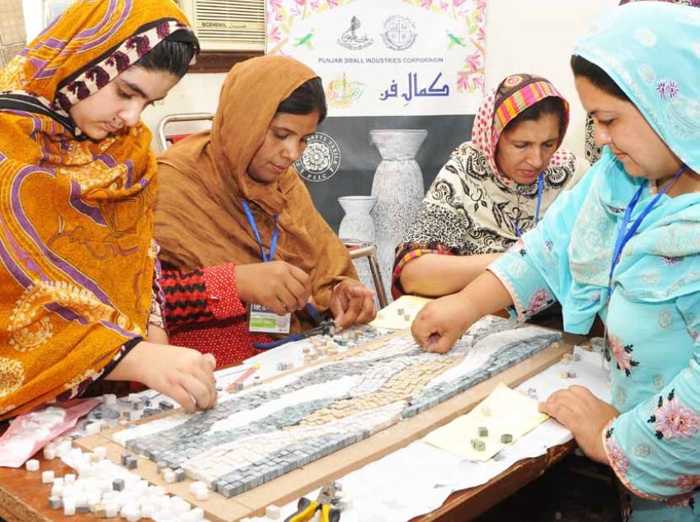

Slide 35
Thanks !

